Slide 1



MICROCONTROLLER BASED SYSTEM DESIGN
CSE 3215
Lecture 4

Slide 2
Key Features of 8051
8 bit CPU
On-chip oscillator
Harvard Architecture
4 KB of on chip ROM
128 bytes of on chip RAM
21 special function registers/Special Function Registers (SFRs) of 128 bytes
32 I/O lines
64 KB address space for external program memory
64 KB address space for external data memory
Two 16-bit timers/counters
One full-duplex serial port
Five source interrupt structure with two priority levels
Bit addressability for Boolean processing

Slide 3
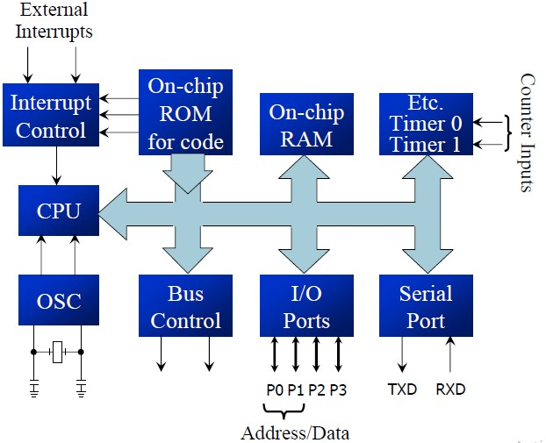
Simplified block diagram of 8051

Slide 4
Memory Organization
Before going deep into the memory architecture of 8051, lets talk a little bit about two variations available for the same. They are Princeton architecture and Harvard architecture. Princeton architecture treats address memory and data memory as a single unit (does not distinguish between two) where as Harvard architecture treats program memory and data memory as separate entities. Thus Harvard architecture demands address, data and control bus for accessing them separately where as Princeton architecture does not demand any such separate bus.
8051 has two memories :- Program memory and Data memory

Slide 5
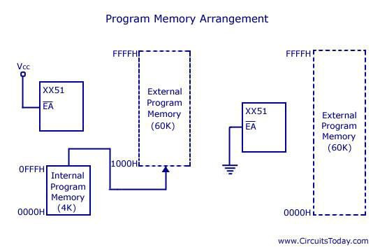
Program memory organization
8051 has an internal program of 4K size and if needed an external memory can be added (by interfacing ) of size 60K maximum.
So in total 64K size memory is available for 8051 micro controller.
By default, the External Access (EA) pin should be connected Vcc so that instructions are fetched from internal memory initially. When the limit of internal memory (4K) is crossed, control will automatically move to external memory to fetch remaining instructions.
If the programmer wants to fetch instruction from external memory only (bypassing the
64k
internal memory), then he must connect External Access (EA) pin to ground (GND).

Slide 6
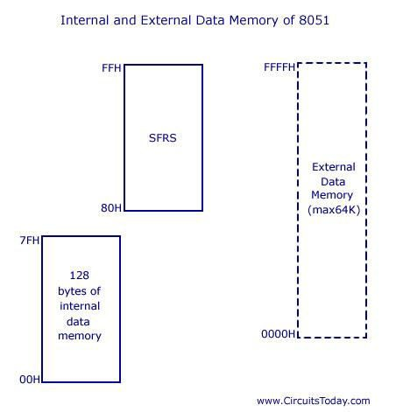
Data memory organization
The data memory comprises 128 bytes of on- chip RAM and 21 Special Function Registers (SFRs).
It allows interfacing external data memory of maximum size up to 64K.

Slide 7
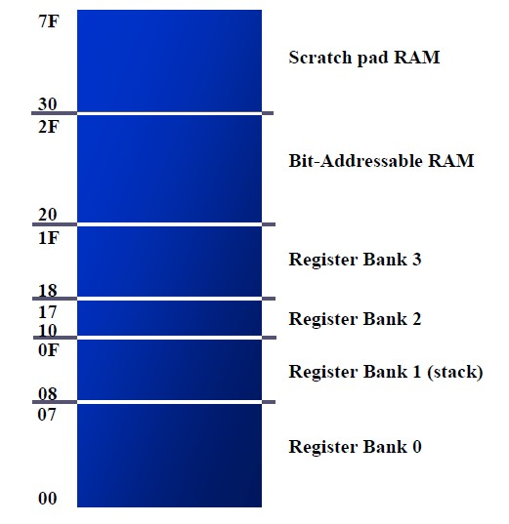
Data memory organization
There are 128 bytes of RAM in the 8051Assigned addresses 00 to 7FH. The 128 bytes are divided into three different groups as follows:
A total of 32 bytes from locations 00 to 1F hex are set aside for register banks and the stack
A total of 16 bytes from locations 20H to 2FH are set aside for bit-addressable read/write memory
A total of 80 bytes from locations 30H to 7FH are used for read and write storage, called scratch pad

Slide 8
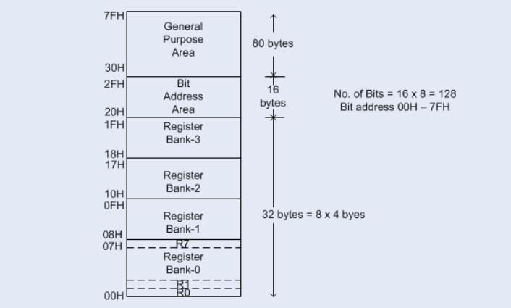
Internal RAM Structure

Slide 9
Data memory organization
These 32 bytes are divided into 4 banks of registers in which each bank has 8 registers, R0-R7
RAM location from 0 to 7 are set aside for bank 0 of R0-R7 where R0 is RAM location 0, R1 is RAM location 1, R2 is RAM location 2, and so on, until memory location 7 which belongs to R7 of bank 0
It is much easier to refer to these RAM locations with names such as R0, R1, and so on, than by their memory locations
Register bank 0 is the default when 8051 is powered up

Slide 10
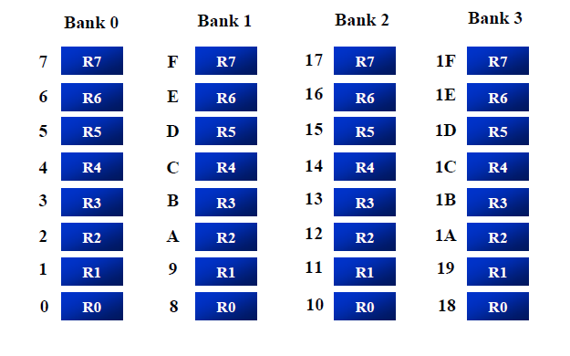
Register banks and their RAM address

Slide 11
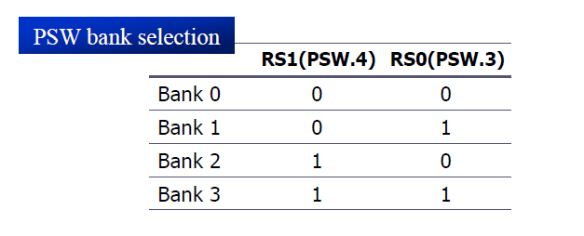
Register banks and their RAM address
We can switch to other banks by use of the PSW register
Bits D4 and D3 of the PSW are used to select the desired register bank
Use the bit-addressable instructions SETB and CLR to access PSW.4 and PSW.3

Slide 12
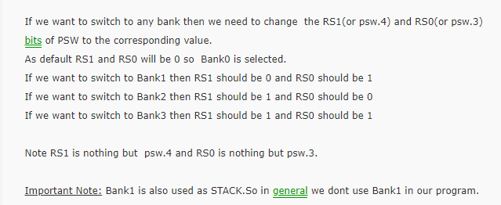
Register banks and their RAM address

Slide 13
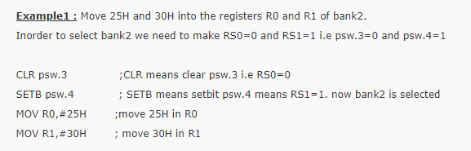
Register banks and their RAM address

Slide 14
Register banks and their RAM address
Exercise 1:
Move 10 H and 12 H into the register R3 and R4 of bank3.

Slide 15
Register banks and their RAM address
Example 1
MOV R0, #99H MOV R1, #85H
Example 2
MOV 00, #99H
MOV 01, #85H
Example 3
SETB PSW.4 MOV R0, #99H MOV R1, #85H
;load R0 with 99H / RAM location 00H has 99H
;load R1 with 85H / RAM location 01H has 85H
;RAM location 00H has 99H
;RAM location 01H has 85H
;select bank 2
;RAM location 10H has 99H
;RAM location 11H has 85H

Slide 16
Stack in the 8051
The stack is a section of RAM used by the CPU to store information temporarily
This information could be data or an address
The register used to access the stack is called the SP (stack pointer) register
The stack pointer in the 8051 is only 8 bit wide, which means that it can take value of 00 to FFH
When the 8051 is powered up, the SP register contains value 07
RAM location 08 is the first location begin used for the stack by the 8051

Slide 17
Stack in the 8051
The storing of a CPU register in the stack is called a PUSH
SP is pointing to the last used location of the stack
As we push data onto the stack, the SP is incremented by one
Loading the contents of the stack back into a CPU register is called a POP
With every pop, the top byte of the stack is copied to the register specified by the instruction and the stack pointer is decremented once

Slide 18
Stack in the 8051
#Example 1
Show the stack and stack pointer from the following. Assume the default stack area.
MOV R6, #25H
MOV R1, #12H MOV R4, #0F3H PUSH 6
PUSH 1
PUSH 4

Slide 19
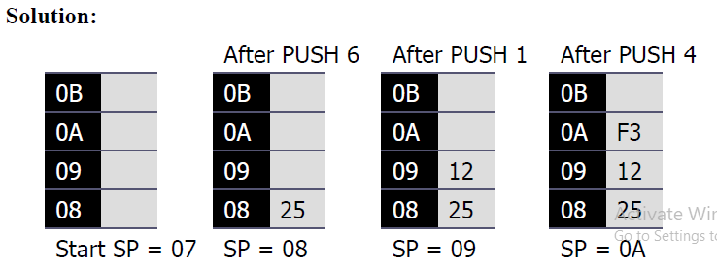
Stack in the 8051

Slide 20
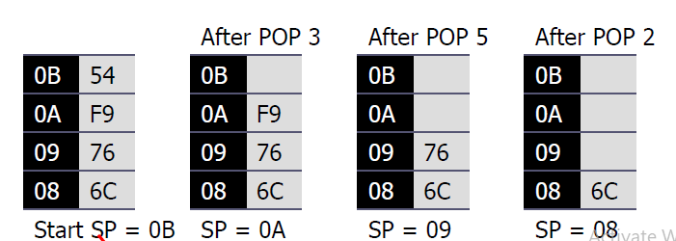
Stack in the 8051
#Example 2
Examining the stack, show the contents of the register and SP after execution of the following instructions. All value are in hex.
POP | 3 | ; POP stack into R3
POP | 5 | ; POP stack into R5
POP | 2 | ; POP stack into R2

Slide 21
Stack in the 8051
The upper limit of the stack
Locations 08 to IF in the 8051 RAM can be used for the stack.
This is because locations 20 – 2FH of RAM are reserved for bit-addressable memory and must not be used by the stack.
If in a given program we need more than 24 bytes (08 to 1FH = 24 bytes) of stack, we can change the SP to point to RAM locations 30 – 7FH.
This is done with the instruction “MOV SP, #xx”.
MOV SP, #62
;make RAM location 63H first stack location

Slide 22
Stack in the 8051
Example:
Write PUSH instructions to push the contents of the registers on stack after the execution of the following set of instructions.
MOV SP,#4FH SETB PSW.3 MOV R0, #25H MOV R1, #0CH MOV R2, #05H MOV A, #0CEH

Slide 23
Stack in the 8051
Solution:
The first instruction defines the stack to be from 50H onwards. The second instruction defines the use of register bank1. Since the register bank 1 has been selected, the addresses of registers R0, R1 and R2 are 8,9,0AH. The address of the A register is 0E0H.
Hence the PUSH instructions are:
PUSH 8
PUSH 9 PUSH 0AH PUSH 0E0H
Stack
Address | Data
53 | CEH
52 | 05H
51 | 0CH
50 | 25H

Slide 24
Stack in the 8051
Incrementing Stack Pointer
As data is pushed onto the stack, SP is incremented. Conversely, it is decremented as data is popped off the stack into the registers. The reason that the SP is incremented after the push is to make sure that the stack is growing toward RAM location 7FH, from lower addresses to upper addresses. If the stack pointer were decremented after push instructions, we would be using RAM locations 7, 6, 5, etc., which belong to R7 to R0 of bank 0, the default register bank.
This incrementing of the stack pointer for push instructions also ensures that the stack will not reach location 0 at the bottom of RAM, and consequently run out of space for the stack.

Slide 25
Stack in the 8051
Stack and bank 1 conflict
There is a problem with the default setting of the stack. Since SP = 07 when the 8051 is powered up, the first location of the stack is RAM location 08, which also belongs to register R0 of register bank 1. In other words, register bank 1 and the stack are using the same memory space. If in a given program we need to use register banks 1 and 2, we can reallocate another section of RAM to the stack. For example, we can allocate RAM locations 60H and higher to the stack.

Slide 26
Stack in the 8051
CALL instruction and the stack
In addition to using the stack to save registers, the CPU also uses the stack to save the address of the instruction just below the CALL instruction. This is how the CPU knows where to resume when it returns from the called subroutine.
CALL instruction is used to call a subroutine
In the 8051 there are two instructions for call:
LCALL (long call) and
ACALL (absolute call)

Slide 27
CALL instruction and the stack
LCALL (long call)
In this 3-byte instruction, the first byte is the opcode and the second and third bytes are used for the address of the target subroutine.
LCALL can be used to call subroutines located anywhere within the 64K-byte address space of
the 8051.
To make sure that after execution of the called subroutine the 8051 knows where to come back to, the processor automatically saves on the stack the address of the instruction immediately below the LCALL.
When a subroutine is called, control is transferred to that subroutine, and the processor saves the PC (program counter) on the stack and begins to fetch instructions from the new location.
After finishing execution of the subroutine, the instruction RET (return) transfers control back to the caller. Every subroutine needs RET as the last instruction.

Slide 28
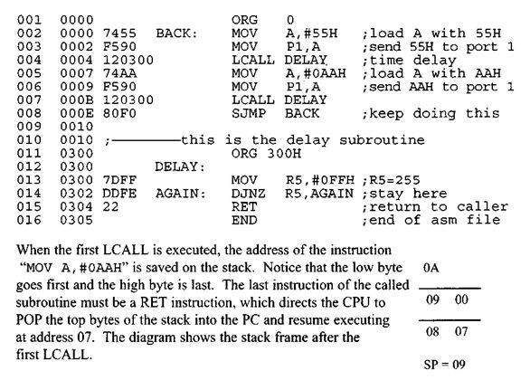
CALL instruction and the stack

Slide 29
CALL instruction and the stack
Notice the
DELAY subroutine. Upon executing the first “LCALL DELAY”,
the address of the instruction right below it, “MOV A, #OAAH”, is pushed onto the stack, and the 8051 starts to execute instructions at address 300H.
In the DELAY subroutine, first the counter R5 is set to 255 (R5 = FFH); there fore, the loop is repeated 256 times. When R5 becomes 0, control falls to the RET instruction, which pops the address from the stack into the program counter and resumes executing the instructions after the CALL.

Slide 30
CALL instruction and the stack
ACALL (absolute call)
ACALL is a 2-byte instruction in contrast to LCALL, which is 3 bytes.
Since ACALL is a 2-byte instruction, the target address of the subroutine must be within 2K
bytes because only 11 bits of the 2 bytes are used for the address.
There is no difference between ACALL and LCALL in terms of saving the program counter on the stack or the function of the RET instruction.
The only difference is that the target address for LCALL can be anywhere within the 64K-byte
address space of the 8051 while the target address of ACALL must be within a 2K-byte range.
In many variations of the 8051 marketed by different companies, on-chip ROM is as low as IK byte. In such cases, the use of ACALL instead of LCALL can save a number of bytes of program ROM space.

Slide 31
Register Organization
Register are used to store information temporarily, while the information could be
a byte of data to be processed, or
an address pointing to the data to be fetched
The registers available in 8051 can be divided into two broad categories
General Purpose Registers (GPSs)
Special Function Registers (SFRs)
The Address Space from 80H to FFH is allocated to SFRs.
Out of these 128 Memory Locations (80H to FFH), there are only 21 locations that are actually assigned to SFRs.

Slide 32
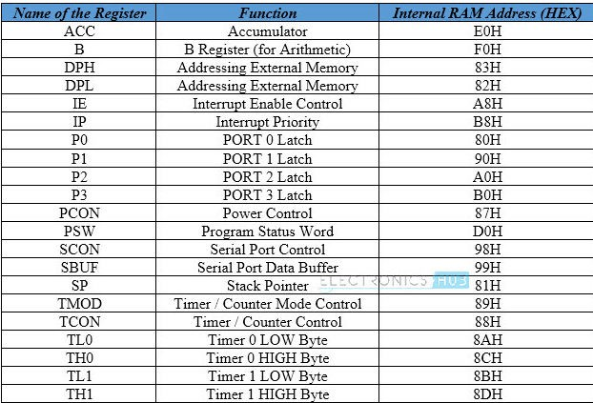
Special Function Registers

Slide 33
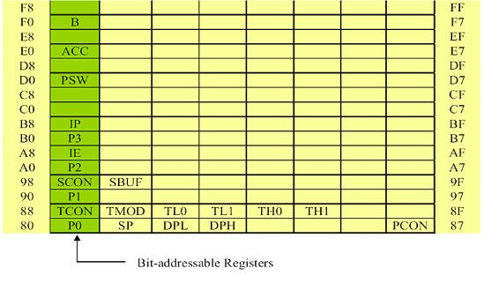
Special Function Registers

Slide 34
Some Common SFRs
A or Accumulator (ACC)
The Accumulator or Register A is the most important and most used 8051 Microcontroller SFRs. The Register A is located at the address E0H in the SFR memory space. The Accumulator is used to hold the data for almost all the ALU Operations.
Some of the operations where the Accumulator is used are:
Arithmetic Operations like Addition, Subtraction, Multiplication etc.
Logical Operations like AND, OR, NOT etc.
Data Transfer Operations (between 8051 and External Memory)

Slide 35
Some Common SFRs
B (Register B)
The B Register is used along with the ACC in Multiplication and Division operations. These two operations are performed on data that are stored only in Registers A and
B. During Multiplication Operation, one of the operand (multiplier or multiplicand) is
stores in B Register and also the higher byte of the result.
In case of Division Operation, the B Register holds the divisor and also the remainder of the result. It can also be used as a General Purpose Register for normal operations and is often used as an Auxiliary Register by Programmers to store temporary results.

Slide 36
Some Common SFRs
Data Pointer (DPTR – DPL and DPH)
The Data Pointer is a 16-bit Register and is physically the combination of DPL (Data Pointer Low) and DPH (Data Pointer High) SFRs. The Data Pointer can be used as a single 16-bit register (as DPTR) or two 8-bit registers (as DPL and DPH).
DPTR doesn’t have a physical Memory Address but the DPL (Lower Byte of DPTR) and DPH (Higher Byte of DPTR) have separate addresses in the SFR Memory Space. DPL = 82H and DPH = 83H.
The DPTR Register is used by the programmer addressing external memory (Program –
ROM or Data – RAM).

Slide 37
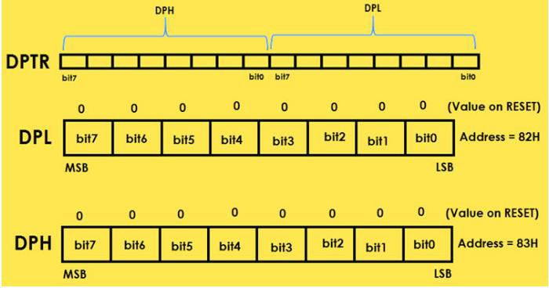
Some Common SFRs

Slide 38
Some Common SFRs
Stack Pointer (SP)
SP or Stack Pointer points out to the top of the Stack and it indicates the next data to be accessed. Stack Pointer can be accesses using PUSH, POP, CALL and RET Instructions. The Stack Pointer is an 8-bit register and upon reset, the Stack Pointer is initialized with 07H.
When writing a new data byte into the stack, the SP (Stack Pointer) is automatically incremented by 1 and the new data is written at an address SP+1. When reading data from stack, the data is retrieved from the Address in SP and after that the SP is decremented by 1 (SP-1).

Slide 39
Some Common SFRs
I/O Port Registers (P0, P1, P2 and P3)
The 8051 Microcontroller has four Ports which can be used as Input and/or Output. These four ports are P0, P1, P2 and P3. Each Port has a corresponding register with same names (the Port Registers are also P0, P1, P2 and P3). The addresses of the Port Registers are as follows: P0 – 80H, P1 – 90H, P2 – A0H and P3 – B0H.
Each bit in these SFRs corresponds to one physical Pin in the 8051 Microcontroller. All these Port Registers are both Bit Addressable and Byte Addressable. Writing 1 or 0 on a Port Register Bit will reflect as an appropriate voltage (5V and 0V) on the corresponding Pin.
If a Port Bit is SET (declared as 1), the corresponding Port Pin will be configured as Input and similarly if a Port Bit is CLEARED (declared as 0), the corresponding Port Pin is configured as Output.

Slide 40
Some Common SFRs
I/O Port Registers (P0, P1, P2 and P3)
The 8051 Microcontroller has four Ports which can be used as Input and/or Output. These four ports are P0, P1, P2 and P3. Each Port has a corresponding register with same names (the Port Registers are also P0, P1, P2 and P3). The addresses of the Port Registers are as follows: P0 – 80H, P1 – 90H, P2 – A0H and P3 – B0H.
Each bit in these SFRs corresponds to one physical Pin in the 8051 Microcontroller. All these Port Registers are both Bit Addressable and Byte Addressable. Writing 1 or 0 on a Port Register Bit will reflect as an appropriate voltage (5V and 0V) on the corresponding Pin.
If a Port Bit is SET (declared as 1), the corresponding Port Pin will be configured as Input and similarly if a Port Bit is CLEARED (declared as 0), the corresponding Port Pin is configured as Output.

Slide 41
Some Common SFRs
Program Status Word (PSW)
The program status word (PSW) register, also referred to as the flag register, is an 8 bit register
Only 6 bits are used
These four are CY (carry), AC (auxiliary carry), P(parity), and OV(overflow)
-They are called conditional flags, meaning that they indicate some conditions that resulted after an instruction was executed
The PSW3 and PSW4 are designed as RS0 and RS1, and are used to change the bank
The two unused bits are user-definable

Slide 42
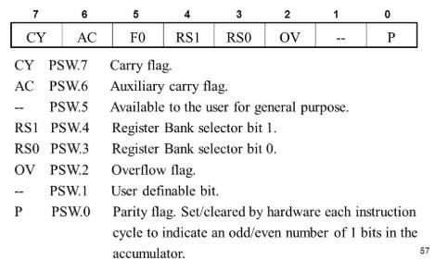
Some Common SFRs

Slide 43
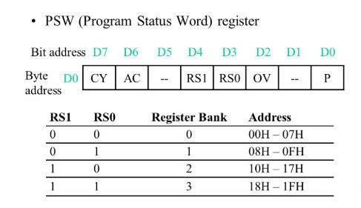
Some Common SFRs

Slide 44
Some Common SFRs
CY, the carry flag
This flag is set whenever there is a carry out from the D7 bit. This flag bit is affected after an 8- bit addition or subtraction. It can also be set to 1 or 0 directly by an instruction such as “SETB C” and “CLR C” where “SETB C” stands for “set bit carry” and “CLR C” for “clear carry”.
AC, the auxiliary carry flag
If there is a carry from D3 to D4 during an ADD or SUB operation, this bit is set; otherwise, it is
cleared.

Slide 45
Some Common SFRs
P, the parity flag
The parity flag reflects the number of 1 s in the A (accumulator) register only. If the A register contains an odd number of Is, then P = 1. Therefore, P = 0 if A has an even number of Is.
OV, the overflow flag
It relates only to signed number arithmetic. This flag is set whenever the result of a signed number operation is too large, causing the high-order bit to overflow into the sign bit.

Slide 46
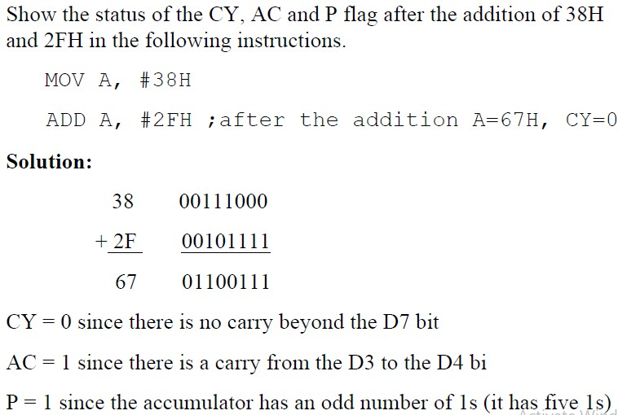
Some Common SFRs

Slide 47
Some Common SFRs
Exercise 1:
Show the status of the CY, AC and P flag after the addition of 9C H and 64 H in the following instructions
MOV A, #9CH ADD A, #64H
Exercise 2:
Show the status of the CY, AC and P flag after the addition of 88 H and 93 H in the following
instructions
MOV A, #88H ADD A, #93H

Slide 48
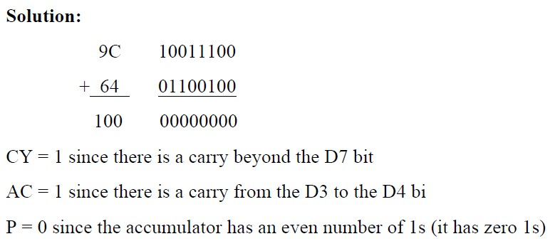
Some Common SFRs
Solution1

Slide 49
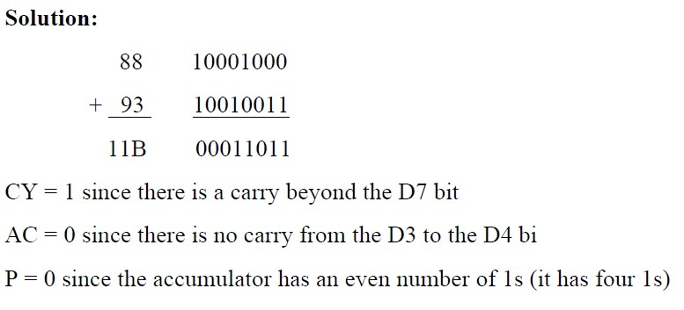
Some Common SFRs
Solution2

Slide 50
Multifunctional I/O ports
There are four ports in 8051 microcontroller named as P0, P1, P2 and P3.
Each port has 8 pins.
For Port 0 8 pins names as P0.0, P0.1, P0.2, P0.3, P0.4, P0.5, P0.6, and P0.7.
To use all these ports as an input port, it must be programmed with 1s.

Slide 51
Multifunctional I/O ports
PORT 0:
Port 0 has 8 pins P0.0, P0.1, P0.2, P0.3, P0.4, P0.5, P0.6, and P0.7, pins 39, 38, 37, 36, 35,
34, 33, 32.
This port can be used for input or output.
It is used to provide lower-order byte address to the external memory devices with the help of the built-in control logic.
When control is '1', the port is used for address/data interfacing.
When the control is '0', the port can be used as a normal bidirectional I/O port.

Slide 52
Multifunctional I/O ports
PORT 1:
Port 1 has no dual function.
It can be use as an input or output.
It 1 has a total of 8 pins. P1.0, P1.1, P1.2, P.13, P1.4, P1.5, P1.6, and P1.7.
The Port 1 must be programmed by writing 1's to all their bits in order to make Port 1 as an input port.

Slide 53
Multifunctional I/O ports
PORT 2:
Port 2 also has total of 8 pins. P2.0, P2.1, P2.2, P2.3, P2.4, P2.5, P2.6, and P2.7.
It can be used for input or output port.
To make Port 2 as an input, the Port 2 must be programmed by writing 1's to all bits.
Port 2 is also designated as A8 - A15.
An 8051 microcontroller is capable of accessing 64K bytes of external memory, it needs a path for the 16 bits of the address. P0 provides the lower 8 bits via A0 - A7 while Port 2 provides the upper 8 bits A8 - A15 of the address.

Slide 54
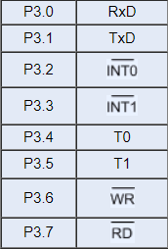
Multifunctional I/O ports
PORT 3:
Port 3 has total 8 Pins. P3.0, P3.1, P3.2, P3.3, P3.4, P3.5, P3.6, and P3.7. Pins 10, 11, 12, 13, 14, 15, 16, and 17.
Each pin of Port-3 can be individually programmed for I/O operation or for alternate function.

Slide 55
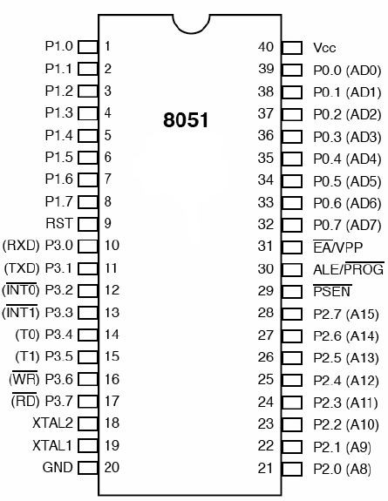
8051 Pin Diagram

Slide 56
Interrupts in 8051
Interrupts provide a method to postpone or delay the current process, performs a sub- routine task and then restart the standard program again.
The 8051 interrupts can be broadly divided into two types:
External Interrupts
Internal Interrupts
External interrupts are activated by some external sources through interrupt input pins, whereas internal interrupts are generated by the on –chip functional units such as timers and serial ports.
The five sources of interrupts in 8051 Microcontroller:
Timer 0 overflow interrupt - TF0
External hardware interrupt – INT0
Timer 1 overflow interrupt - TF1
External hardware interrupt - INT1
Serial communication interrupt - RI/TI

Slide 57
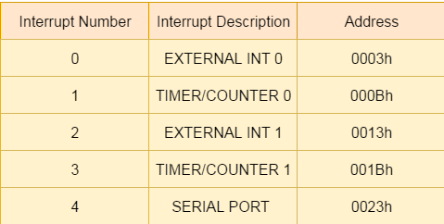
Interrupts in 8051
Vector addresses of the interrupts are shown in the table.
Each of these addresses is the starting address of the
interrupt service subroutine (ISS) for the
corresponding interrupt.
After an interrupt is accepted, execution proceeds starting from the vector address location until a return instruction (RETI) is encountered.

Slide 58
Interrupts in 8051
Steps in executing an interrupt:
Upon activation of an interrupt, the microcontroller goes through the following steps.
It finishes the instruction it is executing and saves the address of the next instruction (PC) on the stack.
It also saves the current status of all the interrupts internally (i.e., not on the stack).
It jumps to a fixed location in memory called the interrupt vector table that holds the address of the interrupt service routine.
The microcontroller gets the address of the ISR from the interrupt vector table and jumps to it. It starts to execute the interrupt service subroutine until it reaches the last instruction of the subroutine, which is RETI (return from interrupt).
Upon executing the RETI instruction, the microcontroller returns to the place where it was interrupted. First, it gets the program counter (PC) address from the stack by popping the top two bytes of the stack into the PC. Then it starts to execute from that address.

Slide 59
Interrupts in 8051
IP (Interrupt Priority) Register
There is a special function IP register, which can be used to assign different priority levels
to each of the interrupt sources.
There are two priority levels:
High Priority Low Priority
When a high-priority interrupt is serviced , it cannot be interrupted by any other source of
interrupts.
However, when a low-priority interrupt is under service , it can be interrupted by a high priority interrupt source.

Slide 60
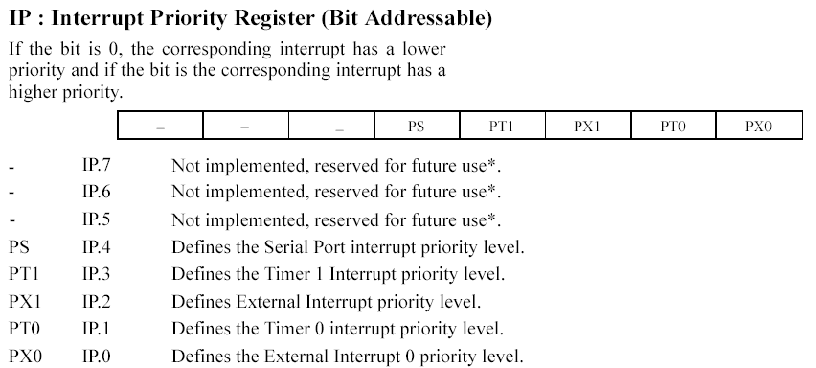
Interrupts in 8051

Slide 61
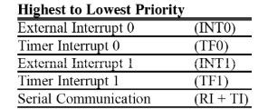
Interrupts in 8051
Apart from the two programmable interrupt levels , an internal polling sequence determines which request is to be serviced.
In the event of multiple interrupt requests of the same priority levels being received simultaneously , the interval polling sequence sets a hierarchy within the same priority level.

Slide 62
Interrupts in 8051
Interrupt Enable (IE) Register
IE register is used for enabling and disabling the interrupt.
This is a bit addressable register in which EA value must be set to one for enabling
interrupts.
The individual bits in this register enables the particular interrupt like timer, serial and external inputs.
Consider in the below IE register, bit corresponds to 1 activate the interrupt and 0 disable the interrupt.
IE: Interrupt Enable Register

Slide 63
Interrupts in 8051
EA | IE.7 | It disables all interrupts. When EA = 0 no interrupt will be acknowledged and EA = 1 enables the interrupt individually.
- | IE.6 | Reserved for future use.
- | IE.5 | Reserved for future use.
ES | IE.4 | Enables/disables serial port interrupt.
ET1 | IE.3 | Enables/disables timer1 overflow interrupt.
EX1 | IE.2 | Enables/disables external interrupt1.
ET0 | IE.1 | Enables/disables timer0 overflow interrupt.
EX0 | IE.0 | Enables/disables external interrupt0.

Slide 64
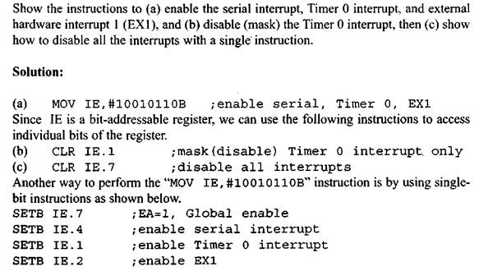
Interrupts in 8051

Slide 65

THANK YOU

